Slide 1
Avanade Data Analytics Tech Call 1 FY21
Mauritius ATC
15 April 2021

Slide 2
Agenda
Overview
Project Eiffage
Project Elior
Project B

Slide 3
Overview
Overview

Slide 4




Eiffage - Introduction
Eiffage is the third largest company in France in the construction sector.
Some of Eiffage projects:
Eiffel Tower
Sydney Opera House
Louvre Pyramid
Channel Tunnel
Millau Viaduct

Slide 5
Eiffage – Team & Technologies
Team members in Mauritius:
Rajiv Jeebodh
Delphine
Technologies used:
SQL Server
SSIS
Power BI

Slide 6
Eiffage – Main Challenges & Solutions
Internal Process
Use CR, Specs and other documents as support.
Time to have access to resources & inadequate resources
Proactive.
Encourage adoption of Power BI vs Excel
Explain users the advantages of using Power BI over Excel.
Power BI training.

Slide 7
Eiffage – Interesting solutions/innovations
Power BI
Menu bar using bookmark and buttons
Pop up screen on mouse hover

Slide 8
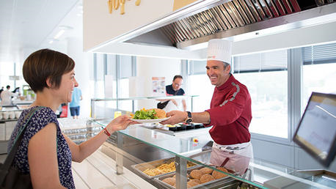
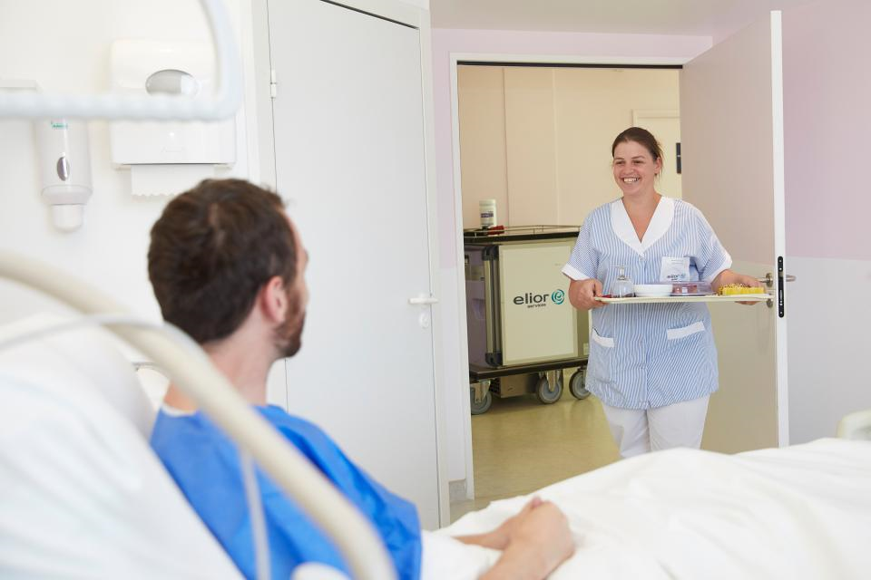
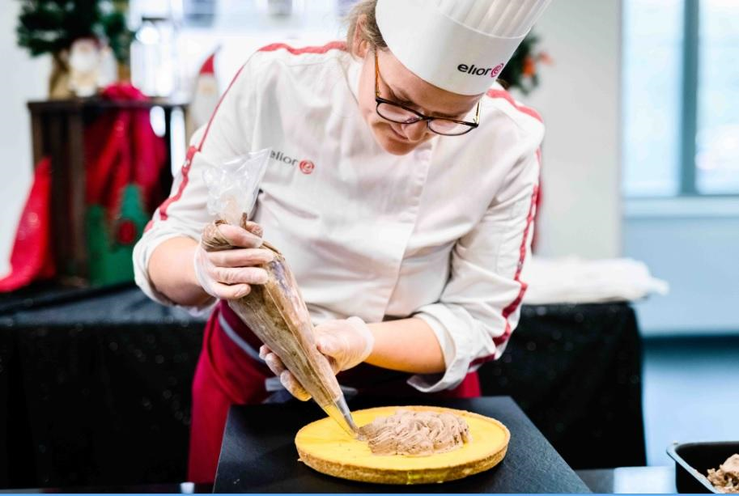

Elior - Introduction
Elior Group is one of the world's leading operators in contract catering and support services in the business & industry, education, healthcare and leisure markets..

Slide 9
Elior – Team & Technologies
Team members in Mauritius:
Nadhim Issop
Shahanah Saumtally
Technologies used:
Azure SQL Database
Azure Data Factory
Azure Analysis Services
Power BI

Slide 10
Elior – Main Challenges & Solutions
Change requests
Use out of the box solutions to implement features on Power BI considering the limitations that Power BI have.
Demo Environment
Use of production data to create dummy clients on the demo environment.
Use of existing client's data to match them to the dummy clients.

Slide 11
Elior – Interesting solutions/innovations
Power BI
Reset button color change on application of any filter.
Display line on existing graphic upon selection of year filter.
Azure Database
Build hierarchy (Parent - child) for account table.
Other components
Automatic deployment of Azure Data Factory / Azure Database / Azure Analysis Services & Power BI reports using Azure DevOps (In discussion / validation).

Slide 12
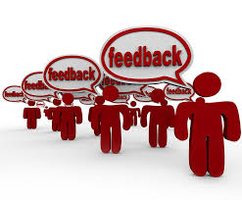

Feedback & Suggestions

Slide 13
Thank You

